Slide 1


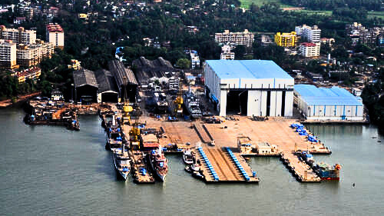


PS-1 Report
Goa Shipyard Ltd.
Presentation By:
BHANU PARIHAR
GIRIK ROUTARAY
VAIBHAV DEVNANI

Slide 2

ABOUT GSL
ISO 9001:2015 for Quality Management Systems (QMS), ISO 14001:2015 for Environment Management Systems, and ISO 45001:2018 for Occupational Health & Safety Management Systems
operates under the administrative control of the Ministry of Defence, Government of India
strategically located on the banks of river Zuari in Vasco Da Gama, Goa, a major international tourist destination well connected by its international airport and major port en route to all important shipping lines
excels in designing and constructing modern patrol vessels with Steel and Aluminium hull structures

Slide 3


HISTORY
1957: Colonial government of Portuguese India established "Estaleiros Navais de Goa" shipyard to construct barges for the flourishing mining industry in Goa
1961: Military annexation of Goa takes place, shipyard falls into Indian hands, now requisitioned to build warships for the Indian Navy and the Indian Coast Guard
in-house design capabilities
caters to both defense and commercial sector
Patrols vehicles ranging from 29m to 110m

Slide 4

THE MODERNISATION PROJECT
4 phased plan includes:
integrated steel fabrication facility
dedicated building berths with shiplift and transfer systems
improved material handling capabilities
advanced crane facilities
GSL seeks to achieve high-quality vessel production, cost competitiveness, shorter construction timelines, faster deliveries, increased capacity, and a diversified product portfolio
based on a "product center concept." - streamlines the ship construction process by establishing four distinct multi-functional production complexes, each equipped for a specific stage of production
minimizing workforce movement within the shipyard, optimizing equipment and tooling efficiency,creating a highly productive work environment while reducing capital investment and operating costs

Slide 5
THE MODERNISATION PROJECT
Phases 1 and 2 of the Modernization Project were commissioned on May 21st, 2011
capable of docking 120-meter vessels weighing up to 6,000 tons
Ship Transfer Area spanning approximately 13,600 square meters
India's first defense shipyard equipped with a modern shiplift facility for launching and docking ships
Upon completion of the project it is expected that:
Shipyard's capacity for fabricating steel, aluminum, and GRP hull vessels will nearly triple
ship repair segment will experience a substantial increase

Slide 6
STRENGTHS
ISO 9001:2015 certified
world-class CAD/CAM facility utilizing the Tribon
ERP-enabled management system integrated with design and planning applications, facilitating effective database management, project monitoring, and control
state-of-the-art Shift Lift facility capable of accommodating vessels weighing up to 6000 tonnes
modern steel preparation shop equipped with
CNC plate-cutting machines
automatic shot blasting equipment
CNC pipe bending machine
modern electronic workshop
skilled workforce of over 1700 personnel, including a team of more than 265 qualified engineers and naval architects

Slide 7
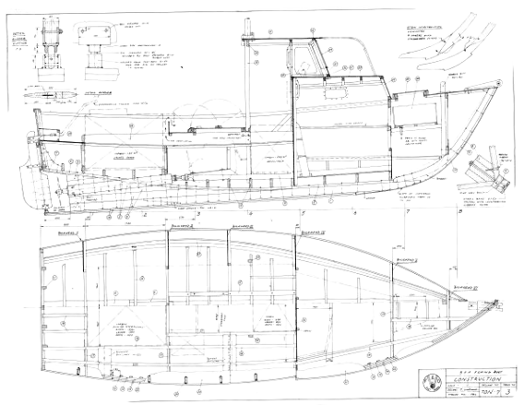
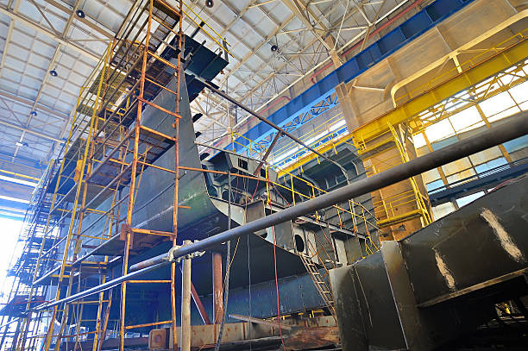
SERVICES OFFERED
vessel design and construction
simulated training facilities
vessel repair and modernization
supply of stern gear
in-house design facility

Slide 8
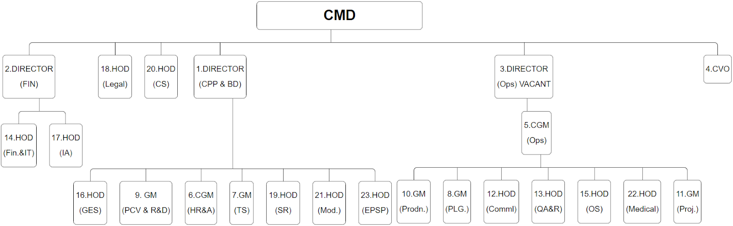
ORGANIZATION CHART

Slide 9
OUTFITTING DEPARTMENT
The outfitting engineering department deals with installation of machinery on the ship, their inspection, conducting trials and commissioning.
Some of the various machineries that are installed are
Main engine
Gear Box
Shaft Generators
Bow Thrusters
Diesel generators
Fuel oil separator
Propeller
Fresh water generator
Fin stabilizer
Air compressor

Slide 10
PROPULSION SYSTEM
Responsible for providing necessary power for movement of the vessel
3 important parts:
Engine
Shafting
Propeller
Engine:
Serves as power source for propulsion system
traditionally diesel or gasoline IC engine
alternatively, can be gas turbines, steam turbines or electric motor
rotational energy generated, transferred to propellers via shafting

Slide 11
PROPULSION SYSTEM
Shafting:
mechanical arrangement of shafts, couples and bearings
transfers power from engine to propeller
primary shaft runs from output shaft of engine through hull towards propeller
sometimes assisted via intermediate shaft for support
Propeller:
Converts rotational energy into thrust
blades attached to a hub
blades push water to generate thrust
adjustable blades to control various functions and optimize running
Together these three systems work together so that ship can run smoothly.

Slide 12
ENGINES
Engines can be mainly divided into 3 types:
Reciprocating Engines
Diesel
Gasoline
Steam
Turbine Engines
LNG
Kerosene/Marine Diesel
Steam
Nuclear-powered steam
Electric Motor
Purely electric (Batteries)
Hydrogen Fuel Cell
Azipods paired with DGs

Slide 13
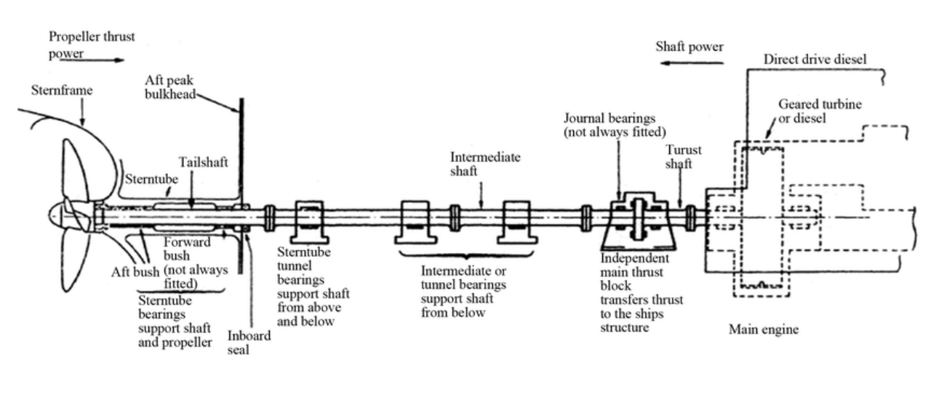
SHAFTING
The shafting system is a vital component in ship propulsion, responsible for transmitting power from the engine to the propeller. It consists of the shafts, bearing, stern tubes, hydraulic lines for CPP, bearings and couplings.

Slide 14
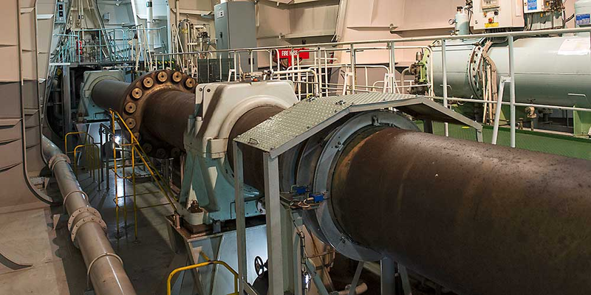
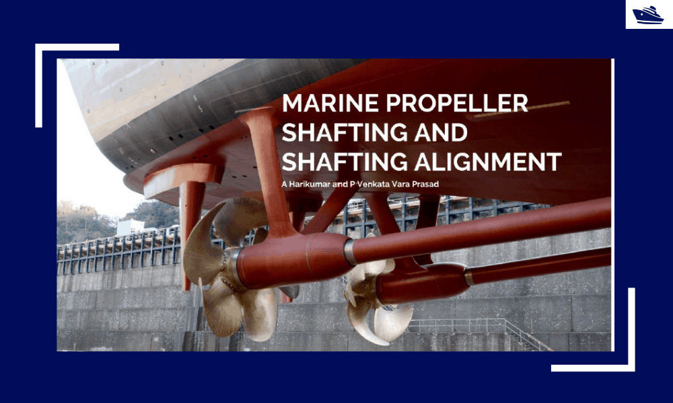
MAIN COMPONENTS OF THE SYSTEM
• Shafts
• Bearings
• Couplings
• Sterntube
• Hydraulic system

Slide 15
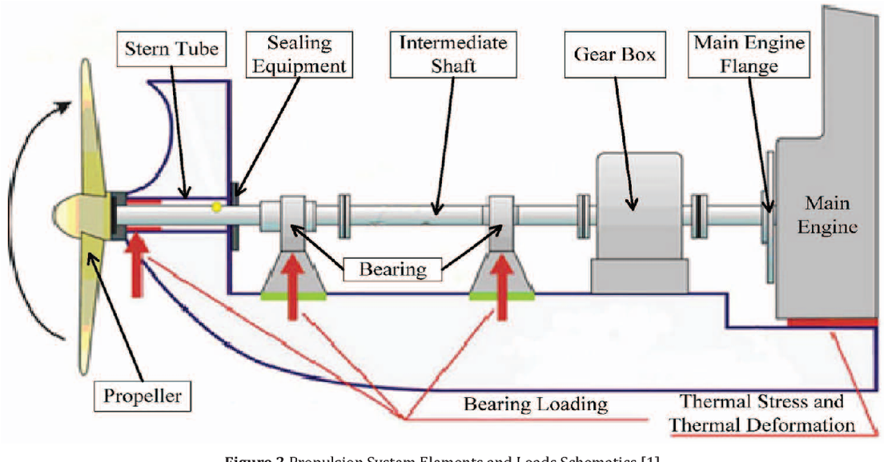
TYPES OF SHAFTS
By Location:
Intermediate Shaft
Stern/Tail Shaft
Propellor Shaft
By Construction:
Hollow Shaft
Solid Shaft

Slide 16
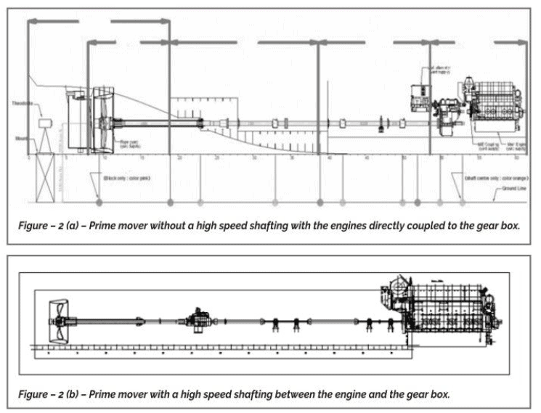
SHAFT ALIGNMENT
Pre-Launch:
Pre Inspection
Initial Installation
Bearing Alignment
Coupling Alignment
Fine Tuning
Post-Launch:
Re-Alignment
Monitoring

Slide 17
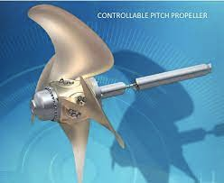
CONTROLLABLE PITCH PROPELLER
A Controllable pitch propeller enables a vessel to operate with maximum fuel efficiency, making it energy-saving, environmentally friendly and economical.
The thrust of a vessel can simply be changed by changing the angle of attack of the propeller blades rather than changing the rpm of the engine, this prevents wasting the engines energy and making the vessel more efficient.

Slide 18
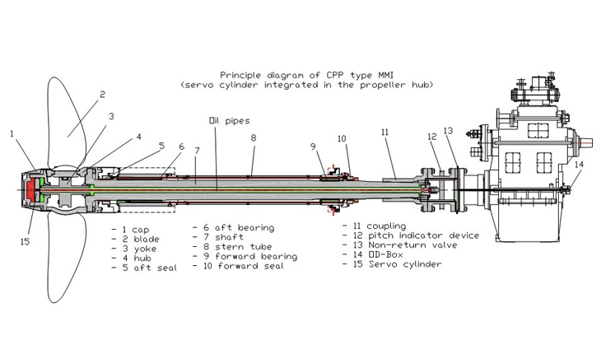
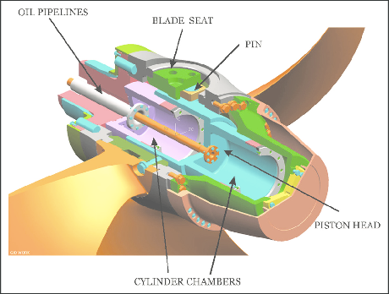
COMPONENTS OF A
CONTROLLABLE PITCH
PROPELLER
• Hub
• Power pack
• Oil distribution box
• Controllable pitch blades
• Hydraulic system

Slide 19
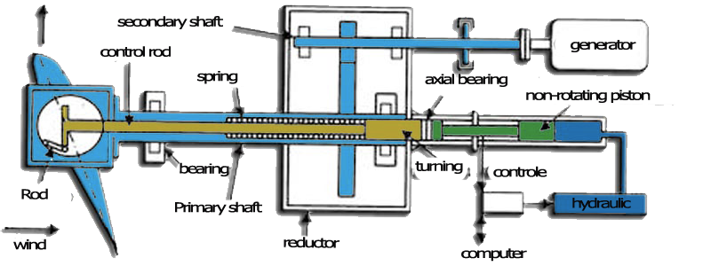
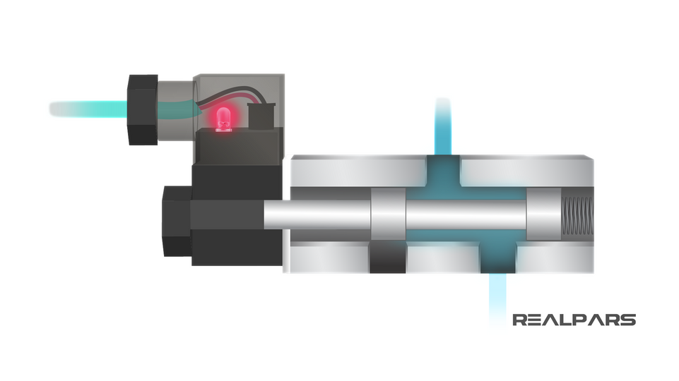
WORKING PRINCIPLE
When the signal is received a spool valve is activated which is in-turn connected to a hydraulic oil pump
A servo motor pushes the hydraulic oil through the pipes inside the hollow shaft.

Slide 20
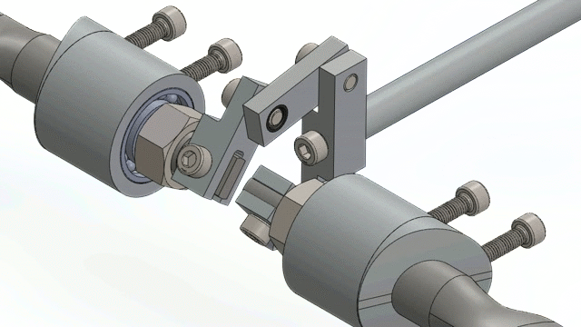
The hydraulic oil pushes a piston inside the hub of the propeller blades.
This piston causes the blades to change pitch using the mechanism shown in the diagram
The controllable pitch propeller system also consists of a feedback system. The pump/servo keeps pushing oil until the feedback signal matches the demand signal

Slide 21
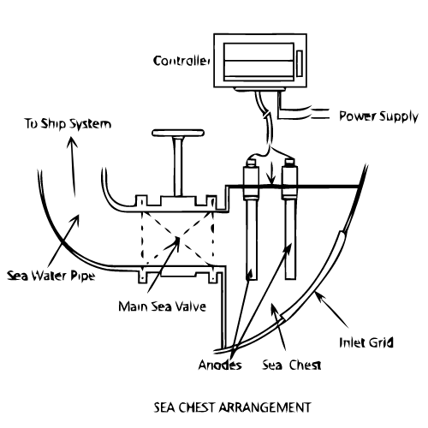
SEA CHEST AND SEA TUBES
Sea Chest
-a chamber located inside the hull of a ship that can be flooded for the intake of water.
Sea Pipes
-responsible for intake of water from the sea chest via pumps.
-provide for various functions inside the ship.
Both are attached with grates to remove debris and organisms
before entering the ship's systems.

Slide 22
APPLICATIONS
Engine Cooling
circulated through heat exchangers to cool down the engine
maintain optimal temp
Machinery Cooling
cooling of other machinery such as pumps, generators, compressors, etc.
Heat Recovery
can be used to redirect heat to required locations such as boiler feed water
Firefighting
pumped quickly to sprinklers and fire hydrant pipes
Ballast Operations
helps balance the ship by redistributing weight in ballast tanks

Slide 23
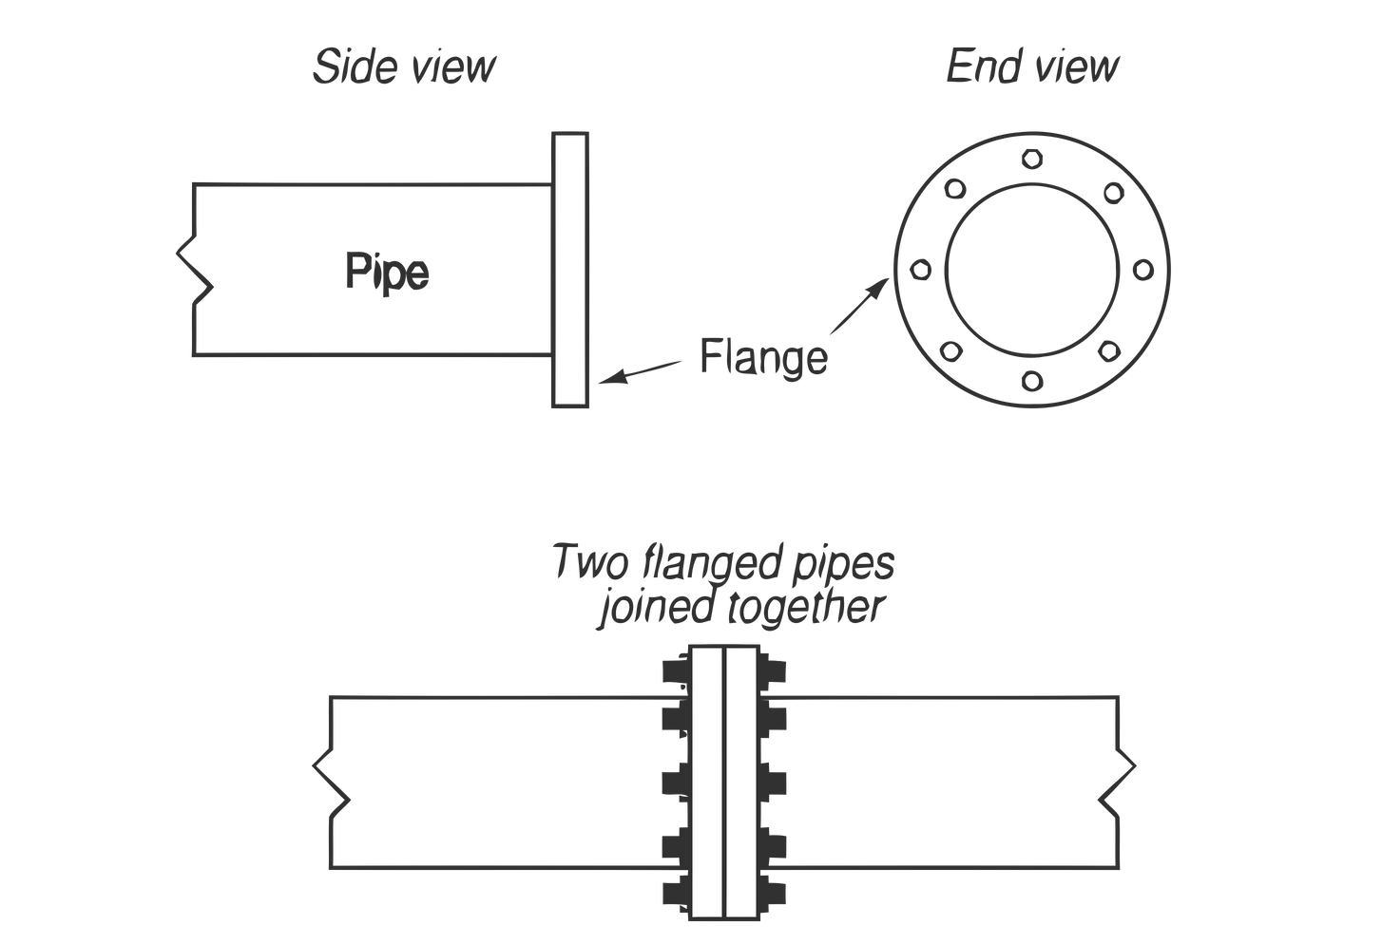
SEA TUBE INSTALLATION
Marking
marks made by referencing diagrams
Hole cutting
holes cut as per marks
Pipe cutting/preparation/flanging
pipe cut and prepared as per needed length and angles
flanges added where connections to be made
Pipe welding
pipes welded to each other and other parts before ship installation
Pickling
Chemically treated and prepared for welding
Fitup
test fitted in ship with all parts before permanent weldś
Complete welding
Fully welded with the main ship body making airtight seals

Slide 24
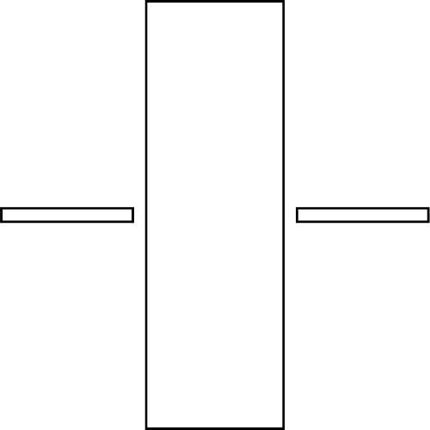
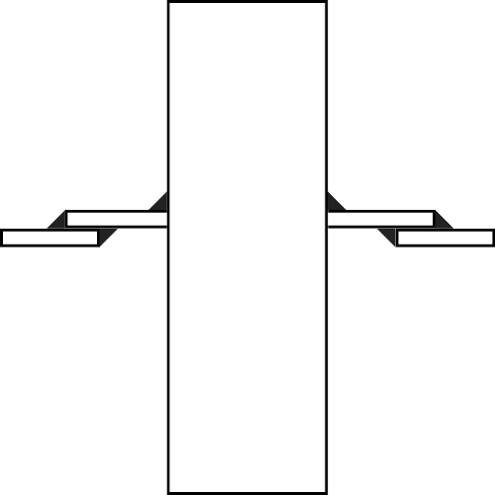
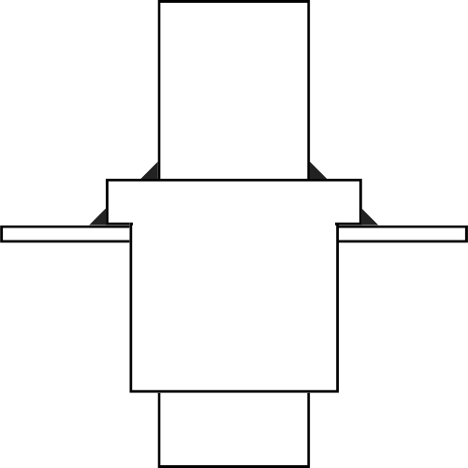
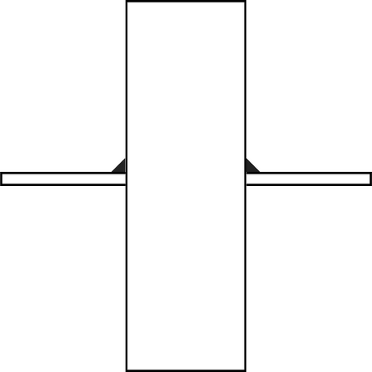
DIFFERENT TYPES OF PIPE WELDS
Simple Weld
Socket Weld
No Weld Pass Through
Doubler Weld

Slide 25
DIESEL GENERATOR
reliable and powerful machines that provide a dependable source of electricity in different settings, including industries, construction sites, and remote areas.
utilize diesel fuel to produce mechanical energy, which is then converted into electrical power
efficient and robust
consistent performance, even under heavy loads,
widely used as backup power solutions
usually have a long lifespan

Slide 26
COMPONENTS
IC Engine
consumes fuel to generate rotational mechanical energy
goes through 4 processes- Suction, Compression, Power, Exhaust
attached to crankshaft
Alternator
attached to the other end of the crankshaft
has inbuilt magnets and conductive copper wiring that rotates
uses induction to generate electricity
Fuel System
responsible for supply of fuel
includes pump, filter, ventilation pipe, etc needed for fuel flow
Lubrication System
helps smoothly run all the various moving parts
avoids heating up of parts so that temp is maintained optimal

Slide 27
COMPONENTS
Voltage Regulator
maintains stable output voltage and avoids fluctuations
Cooling System
runs coolant fluid to maintain optimal operational temp
generally water
Exhaust System
safely channels away toxic fumes released during combustion in the engine
Starter And Battery System
helps initially start the diesel motor, similar to a car battery
Control Panel
houses controls for all the various parameters like fuel flow, output voltage, start/stop switch, etc.
Housing/Frame
covers and protects all the components of the generator in one single shell

Slide 28
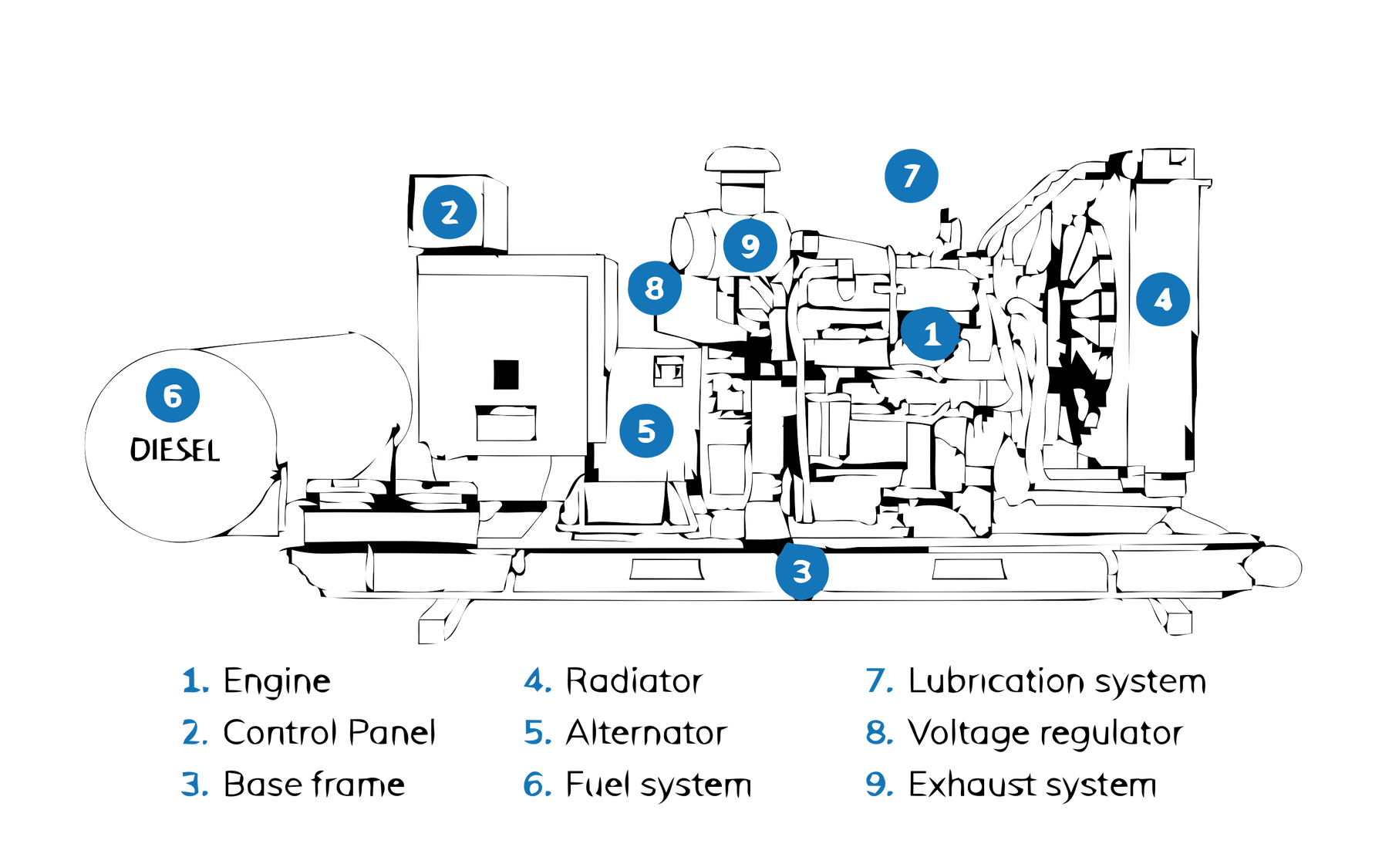
WORKING PRINCIPLE
Diesel generators go through four combustion processes: Suction, Compression, Power, and Exhaust. The cycle of processes causes the generation of rotational mechanical energy. This energy is transferred to a rotor in the alternator via a crankshaft. The alternator houses conductive copper wiring which spins inside a housing of magnets. This generates a voltage that alternates as per the rotation speed of the shaft

Slide 29
USAGE ON SHIPS
supplying electrical power to different systems and equipment on the ship, including lighting, navigation systems, communication systems, refrigeration, ventilation, and various machinery.
provide backup power in case of a main power failure.
ensure critical systems like emergency lighting, communication, and essential equipment continue to operate during power outages
in some ships, can also be used for propulsion in case of emergency
utilized for refrigeration systems on ships to maintain the required temperature in cold storage areas, such as for perishable goods, provisions, and medical supplies.
provide power for welding and maintenance activities onboard ships needed for repairs and maintenance work.

Slide 30
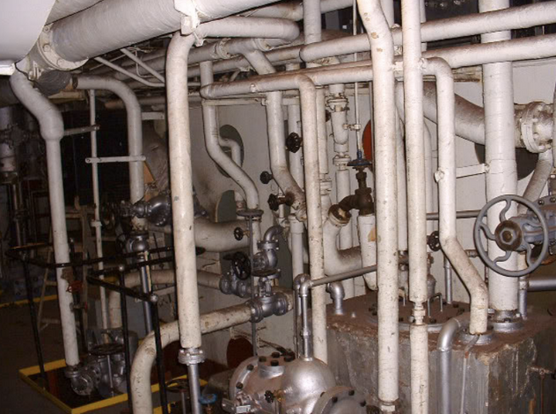
PIPE BENDING
Various systems and machineries in ships require very complex piping involving 100s of pipes to be precisely routed in a very constrained space.
Required for - Cooling water circulation, fresh water supply, fuel transport, lubrication system, ballast systems, hydraulic systems
Complex routing requires a lot of joints and bends, joints usually introduce higher costs, failure points and increased manufacturing time so bending is preferred method to go to accomplish complex plumbing.

Slide 31
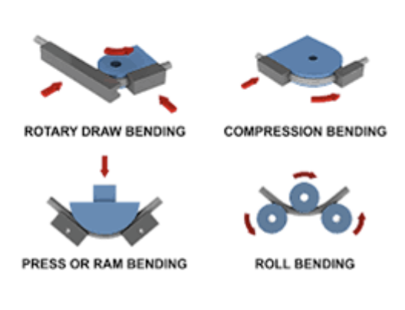
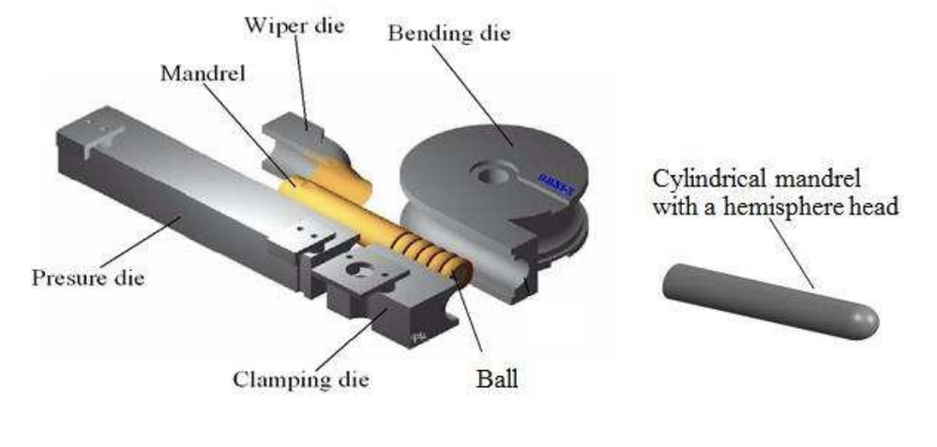
PIPE BENDING METHODS
4 commonly used methods
Rotary Draw Bending
Compression Bending
3 point roll bending
Ram Bending
Rotary draw bending with 1 axis and 3 axis semi-automatic and automatic CNC machines is mainly done here. With support for pipes up to 60mm.

Slide 32
CHALLENGES IN PIPE BENDING
Thinning - The challenge of maintaining consistent material thickness during pipe bending to prevent structural weakness or failure
Folding - The challenge of preventing undesirable creases or folds in the pipe wall during bending, which can compromise its integrity.
Wrinkling - The challenge of avoiding the formation of wrinkles or ripples on the inner or outer surface of the bent pipe, which can affect its functionality or aesthetics.
Roundness - The challenge of achieving and maintaining the desired circular shape of the pipe after bending, ensuring proper fit and alignment in the intended application.
Springback - The challenge of accounting for the tendency of the pipe to return partially to its original shape after bending, requiring careful calculation and adjustment to achieve the desired final shape.

Slide 33
WAYS TO OVERCOME CHALLENGES
Proper selection of bending equipment, such as mandrels, dies, and supports, to minimize material deformation.
Choosing the right bending technique, such as rotary draw bending, mandrel bending, or heat induction bending, depending on the pipe material, size, and application.
Applying appropriate lubrication or mandrel coatings to reduce friction and improve material flow.
Using high-quality materials with suitable mechanical properties for bending applications.
Conducting thorough pre-bending analysis and simulation to identify potential issues and optimize the bending process.
It is important to note that the specific challenges and their solutions may vary depending on factors such as the pipe material (e.g., steel, aluminum, copper), wall thickness, diameter, and the complexity of the bend.

Slide 34
CHALLENGE OF SPRINGBACK
Even after overcoming all the challenges of thinning, wrinkling, roundness etc. the challenge of managing springback is crucial for achieving precise and accurate pipe bends. Here are some strategies to address this challenge:
Over-Bending
Heat Treatment
Multiple step bending
Slow bending
Material Selection
Easiest and commonly used method is Over-Bending, which involved bending the pipes a couple extra degrees so that it can achieve required dimension on springback

Slide 35
PREDICTING SPRINGBACK
Various analytical techniques have been researched and developed to predict the springback to compensate it with overbending, but most of them don’t offer results of more than 5-7% accuracy due to the large number of factors involved in the process namely:
Bending Method
Ram Bending
Arc Draw Bending
Three Point Bending
Die Bending
Material Properties
Young's Modulus
Hardness Coefficient
Cracks in material
Wall thickness
Hardening Method
Temperature
Bending Speed
Lubrication
Mandrel Type
Bead Mandrel
Ball Mandrel
Die/Mandrel Material
Coating/Paint on pipes

Slide 36
PREDICTING SPRINGBACK
Involvement of all these factors make it very hard to get general analytical solutions, the only way to predict accurately is via FEM simulations.
In Industrial applications, automatic machines take advantage of feedback mechanisms to use with a linear/quadratic regression model to get accurate predictions for a pipe type.
Our goal was to develop a solution for the semi automatic machines to calculate the compensation angle in advance to prevent springback.
The springback angle is almost linearly related to the bending angle and this property can be used to predict the springback angle for compensation.

Slide 37
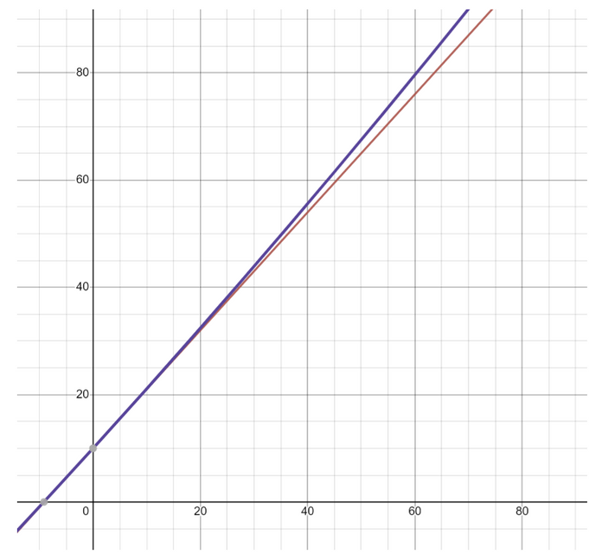
PREDICTING SPRINGBACK
Method to determine the springback -
Bend the pipe by about 30-60 degrees and then measure the final angle, and then repeat the process for a couple of times. This data can be used to calculate the empirical formula to calculate the springback angle for each type of pipe.
The formula that would be obtained will be -
BA = C(RA) + SC
Where,
BA = Bending Angle
RA = Required Angle
SC = Springback Constant (5-15)
C = Proportionality Constant (1.025-1.075)

Slide 38
PREDICTING SPRINGBACK
This formula can be used to get compensation angles and can achieve results upto 2% accuracy, way higher than theoretical methods. And this just requires 2 test values to begin with.
To get even higher accuracy, quadratic correction term can be introduced which can get less than 1% error
BA = C(RA) + SC + SC*RA^2*QC
Where,
BA = Bending Angle
RA = Required Angle
SC = Springback Constant (5-15)
C = Proportionality Constant (1.025-1.075)
QC = Quadratic Constant (0.0001-0.001)

Slide 39
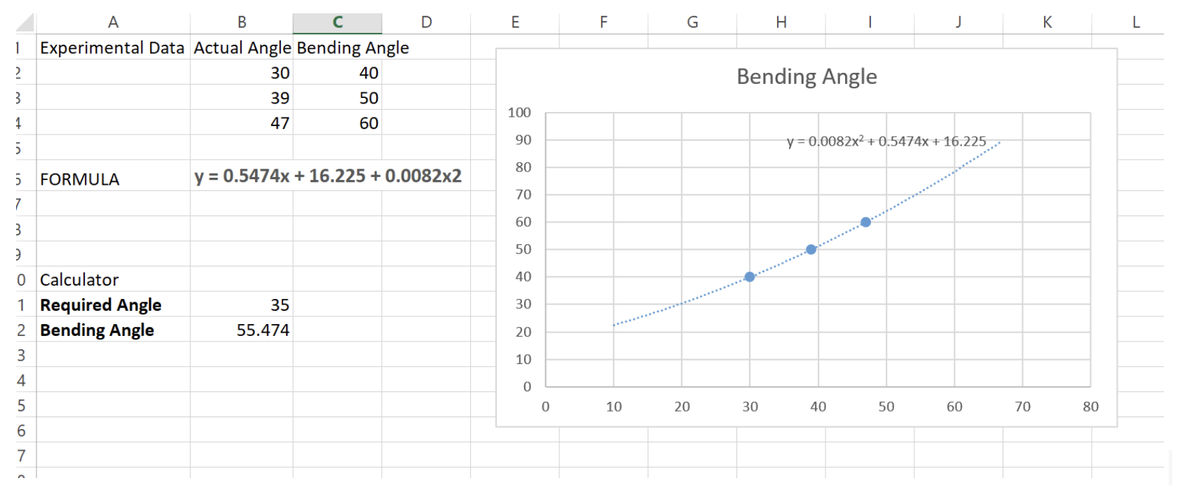
PREDICTING SPRINGBACK
This can be implemented in an excel spreadsheet to calculate the compensation angle for a specific type of pipe.

Slide 40


VESSELS WE WORKED ON

Slide 41

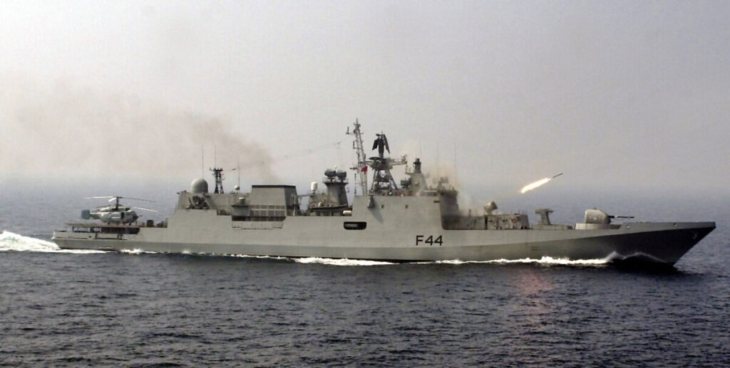
TALWAR CLASS FRIGATES
• guided missile frigates built for the Indian Navy.
• build in collaboration with Russian Yantar shipyard.
• have a stealthy design making them less visible to enemy radar
•They are armed with an array of weapons, including BrahMos supersonic cruise missiles, surface-to-air missiles, anti-ship missiles, torpedoes, and guns.

Slide 42

SPECIFICATIONS
Disp. 3,850 t (4,240 short tons) standard load [3] 4,035 t (4,448 short tons) full load [4]
Length. 124.8 m (409 ft 5 in)
Beam. 15.2 m (49 ft 10 in)
Draught. 4.2 m (13 ft 9 in)
Speed. 32 knots (59 km/h; 37 mph)
Time. 30 days
Crew. 180 (18 officers)

Slide 43
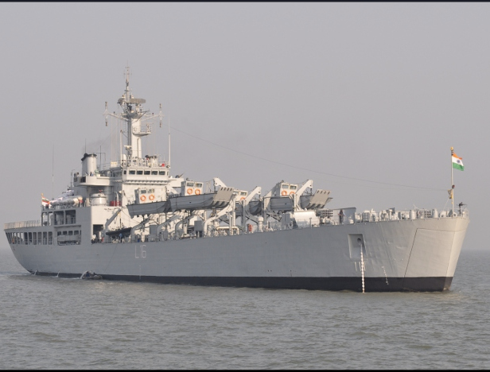
INS SHARDUL
• INS Shardul is an amphibious warfare ship of the Indian Navy, also known as landing craft.
• primarily used to transport troops, vehicles and equipment for launching land based attacks.
• the ship has the capability to come very close to land/beaches to deploy troops
• it can carry up to 500 troops, along with their vehicles and supplies.
• it is used extensively to carry out humanitarian missions.

Slide 44
SPECIFICATIONS
Displacement. 5650 tons
Length. 125 m (410 ft)
Beam. 17.5 m (57 ft)
Draught. 4 m (13 ft)
Propulsion. Kirloskar PA6 STC engines
Speed. 16 kn (30 km/h; 18 mph)
Troops. 500
Crew. 11 officers, 145 sailors

Slide 45
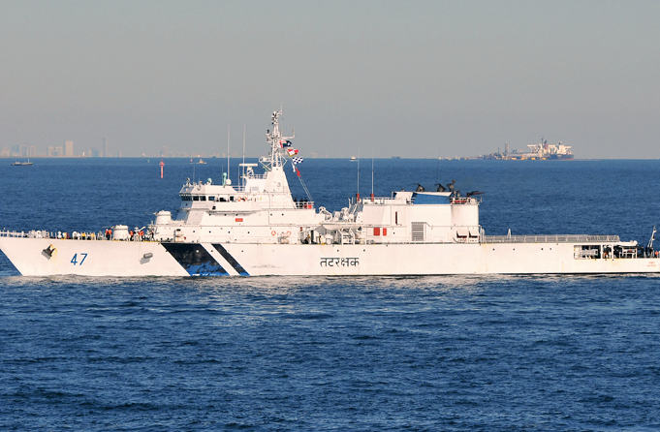
ICGS SAGAR
•ICGS Sagar is an offshore patrol vessel (OPV) of the Indian Coast Guard. It is part of the Sagar-class OPVs and serves as a versatile platform for maritime security and surveillance operations.
•ICGS Sagar is armed with medium and light machine guns for self-defense and maritime law enforcement purposes.

Slide 46


SPECIFICATIONS
Displacement. 1,800 t (1,800 long tons)
Length. 102 m (334 ft 8 in)
Beam. 11.5 m (37 ft 9 in)
Draught. 3.4 m (11 ft 2 in)
Propulsion. 2 x SEMT Pielstick 16 PA6V280 (4,707 kW or 6,312 hp each) diesel engines
Speed. 22 knots (41 km/h; 25 mph)
Complement. 15 officers and 113 sailors

Slide 47
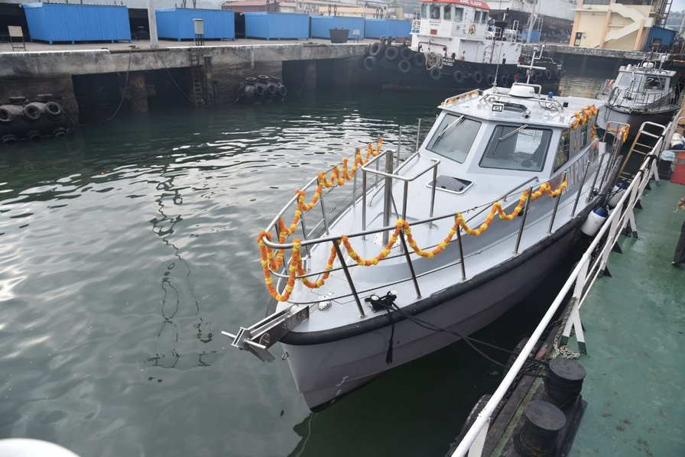
ARMY FAST PATROL BOATS
• the fast patrol boats will be commitioned by the Indian Army in high altitude regions of Leh and Ladakh
• they have a operating speed of 35 to 40 knots and are armed with two heavy machine guns.
• these fast patrol vessels are being manufactured using futuristic manufacturing methods and are made of mould based fibre.

Slide 48
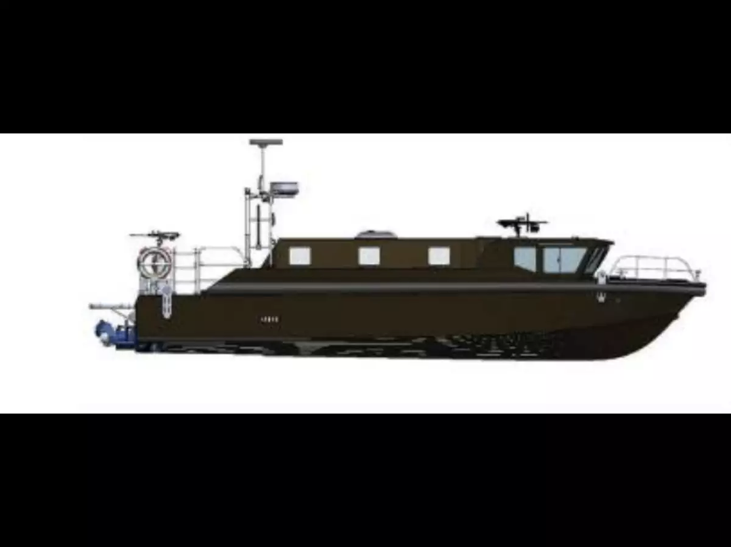
SPECIFICATIONS
Length : 35 m
Maximum speed : 35 to 40 knots
Armaments: 2 heavy machine guns

Slide 49
THANKYOU

